Slide 1

Analyzing GNN Models for Community Detection Using Graph Embeddings: A Comparative Study
Team Number:DB4
ROLL NO. | NAME
AM.EN.U4CSE20339 | Krishnpriya Dinesan
AM.EN.U4CSE20366 | Sreesankar S
AM.EN.U4CSE20321 | Devesh Kumar V V
AM.EN.U4CSE20152 | Pranav B Nair
Amrita School of Computing | Amrita Vishwa Vidyapeetham | Amritapuri

Slide 2
Introduction
Focus: examines the efficacy of Graph Neural Networks (GNNs) in community detection within complex networks across various domains.
Goal: Our aim is to explore novel approaches leveraging GNNs to uncover underlying patterns and relationships within interconnected systems.
Solution: By harnessing the capabilities of GNNs, we seek to address the limitations of traditional community detection algorithms and provide more effective solutions for analyzing complex network structures.
Benefits: The research outcomes have the potential to advance our understanding of complex systems and facilitate more accurate and efficient network analysis techniques, benefiting various domains such as social networks, citation networks, and biological systems.

Slide 3
Motivation
Personalization: Allows for personalized content recommendations and tailored user experiences based on community interests.
Network Understanding: Helps understand the structure and dynamics of social networks, facilitating targeted marketing strategies.
User Engagement: Enhances user engagement by fostering connections within communities, leading to increased platform activity and retention.

Slide 4
Background Study/Related Work
Title &year | Problem | Contributions | Limitations | Open problems/Future work
Community Detection using Semi-supervised Learning with Graph Convolutional Network on GPUs IEEE [2020] | Utilizes GCNs with limited data for efficient community detection, leveraging GPU acceleration, and scalable techniques for real-world networks. | A semi-supervised learning method for community detection in large networks, achieving 86.9% accuracy with 4x speedup on 2 GPUs, using GCNs, Minibatch Gradient Descent, and node-based features, validated across seven domains. | Challenges involve reliance on labeled data, scalability issues with large networks, performance variability based on features, and limited focus on generalization, metrics, and hyperparameters. | Future research should enhance model generalization, address scalability challenges, reduce labeled data dependency, optimize hyperparameters, improve efficiency, and explore novel semi-supervised techniques.

Slide 5
Background Study/Related Work
Title &year | Problem | Contributions | Limitations | Open problems/Future work
A Comprehensive Survey on Community Detection With Deep Learning [2020] | An updated understanding of community detection methods using deep learning techniques is crucial for effectively handling high-dimensional network data compared to traditional approaches such as spectral clustering and statistical inference. | Introduces a Taxonomy which includes DNNs, deep matrix factorization, sparse filtering, insights on CNNs, GANs, acknowledging limitations in covering recent advancements, diverse settings. | Survey's comprehensiveness may lag due to rapid research pace, relying on existing evaluations could limit performance assessment breadth. | Future GCN research should focus on robustness, scalability, interpretability, dynamic detection, and cross-domain applications for real-world impact.

Slide 6
Background Study/Related Work
Title &year | Problem | Contributions | Limitations | Open problems/Future work
Unified Community Detection with Graph Convolutional Networks Springer [2023] | UCoDe, a Graph Neural Network with a novel contrastive loss, to address community detection in networks, outperforming existing methods in identifying overlapping and non-overlapping communities | UCoDe excels in detecting communities, optimizing network modularity with contrastive loss, showing superior performance over existing models. | UCoDe's limitations include sensitivity to hyperparameters, scalability challenges with larger datasets, reliance on heuristics, and performance variability. | Areas for exploration include scalability, hyperparameter sensitivity, diverse dataset performance, overlapping community detection methods, and graph handling improvements.

Slide 7
Background Study/Related Work
Title &year | Problem | Contributions | Limitations | Open problems/Future work
Semi-Supervised Learning for Community Detection in Large-Scale Networks [2020] | Paper addresses Community detection in large networks is computationally challenging with limited labeled data. | Introduces a semi-supervised model with 86.9% accuracy and 0.85 F1 score, made scalable with Mini-batch Gradient Descent, tested in seven domains. | Node-based features perform worse than identity matrix-based ones, memory constraints affect accuracy, and performance varies with dataset characteristics. | Enhancing GCN scalability and efficiency through optimized architecture, including layer structures and activation functions, and exploring tailored feature extraction methods.

Slide 8
Persisting Challenges
Challenges Identified
Generalization
Scalability
Dependency
Efficiency

Slide 9
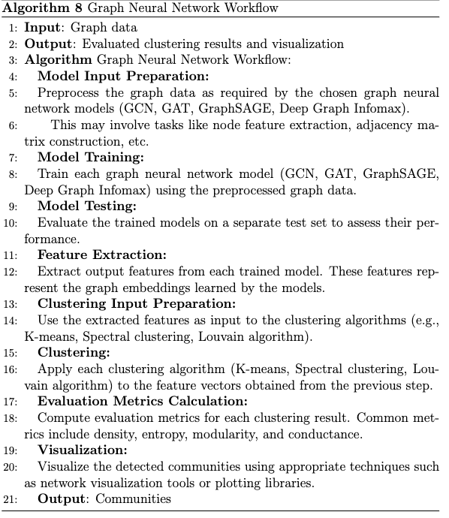
Project Overview

Slide 10
Project Contributions
The project contributes by conducting a comparative study on GNN models for community detection,comparing effectiveness and advancing graph embedding techniques' understanding.
What are the objectives?
The project aims to evaluate Graph Neural Networks (GNNs) for node classification and community detection tasks, exploring models like GCN, GAT, GraphSAGE, and Deep Graph Infomax.

Slide 11
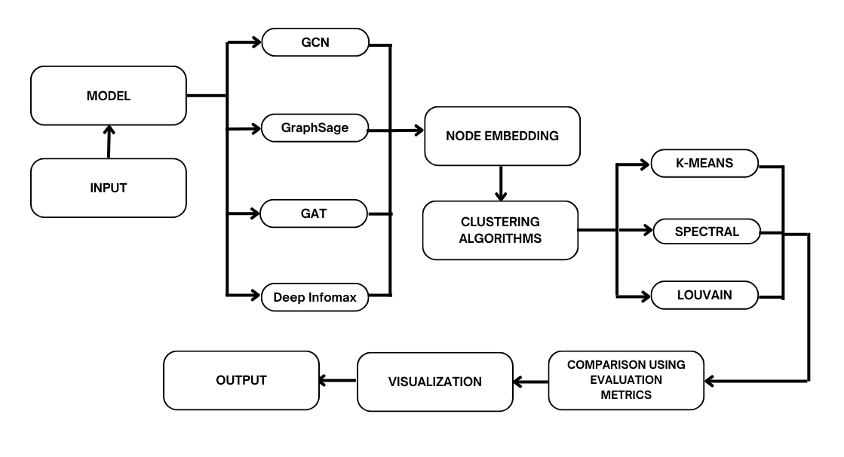
High Level Design

Slide 12
Algorithms/Methodology
The algorithms used in this project are:
Graph Neural Networks (GNNs) such as GCN, GAT, GraphSAGE, and Deep Graph Infomax for node classification and community detection tasks.
Clustering algorithms including spectral clustering, k-means clustering, and the Louvain algorithm for detecting communities within graphs.

Slide 13
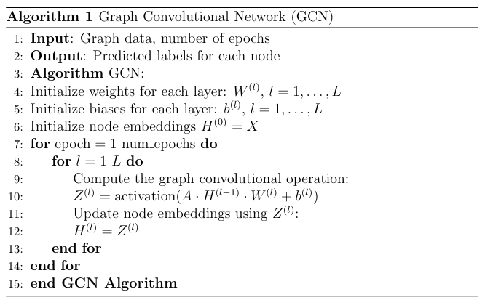
Algorithms/Methodology
1. Graph Convolutional Networks (GCN):
Graph Convolutional Networks (GCN) are a type of neural network architecture designed to operate on graph-structured data.
They extend traditional convolutional neural networks to graphs by performing convolutional operations on the nodes of the graph.

Slide 14
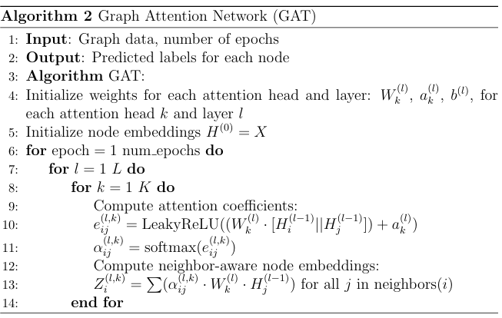
Algorithms/Methodology
2. Graph Attention Networks (GAT):
Graph Attention Networks (GAT) are a variant of Graph Convolutional Networks (GCNs) designed to address the limitations of traditional convolutional operations on graphs.
Extends GCNs by employing attention mechanisms to selectively aggregate information from neighbouring nodes, dynamically prioritizing important features based on attention weights.

Slide 15
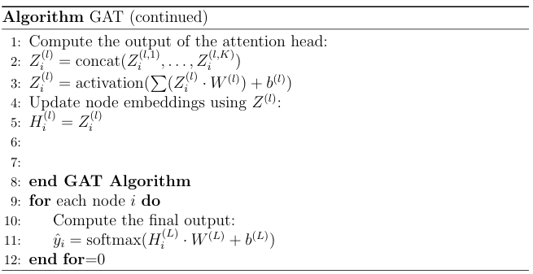

Slide 16
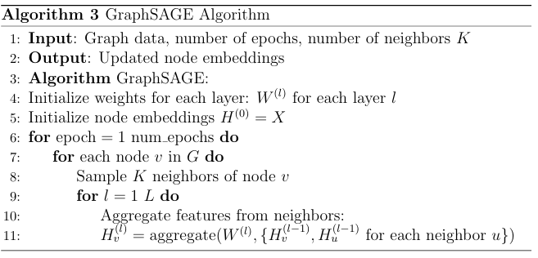
Algorithms/Methodology
3. GraphSAGE (Graph Sample and Aggregation):
Inductive representation learning framework for large graphs, creating node embeddings by aggregating feature data from neighbouring nodes using various aggregation algorithms like mean, max, or LSTM.
It's designed to efficiently learn node embeddings by sampling and aggregating information from the neighborhood of each node.

Slide 17
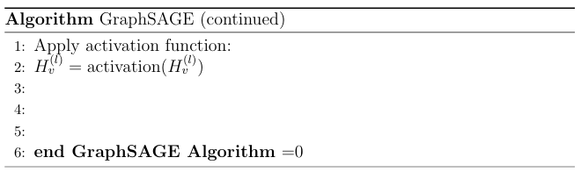

Slide 19
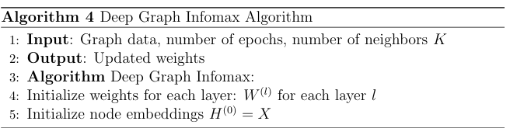
Algorithms/Methodology
4. Deep Graph Infomax:
Unsupervised learning technique for learning graph representations by maximizing mutual information between graph structures and node representations, identifying important dependencies and patterns in the graph without requiring explicit supervision.

Slide 20
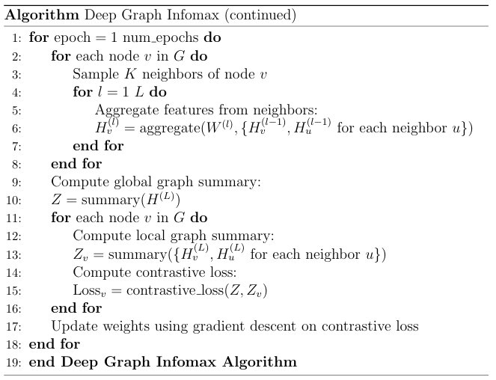

Slide 21
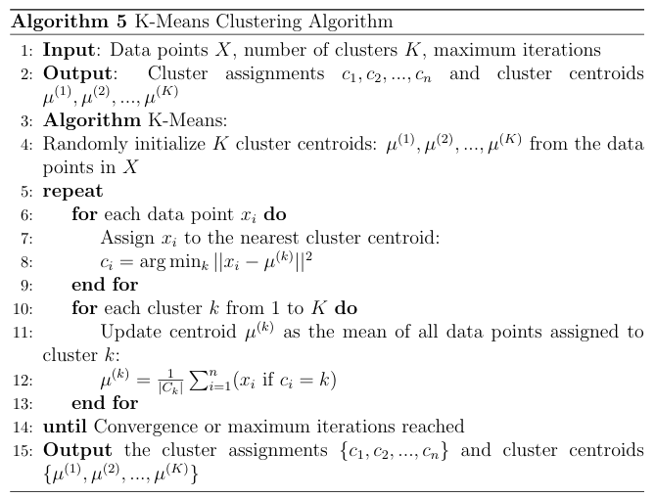
Algorithms/Methodology
5. K-Means Clustering:
K-means clustering is a popular unsupervised learning algorithm used for partitioning data into 𝑘k clusters based on similarity.
It aims to minimize the sum of squared distances between data points and their respective cluster centroids.

Slide 22
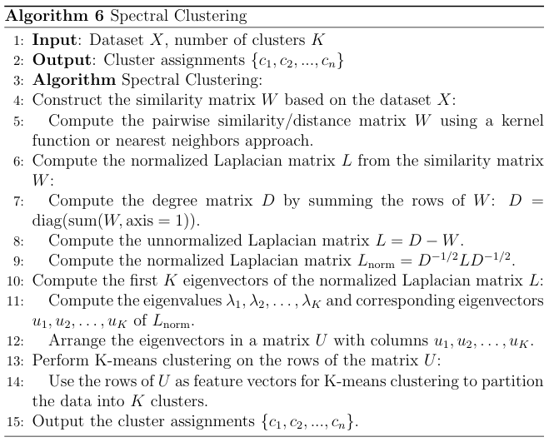
Algorithms/Methodology
6. Spectral Clustering:
Spectral clustering is a powerful technique for partitioning data into clusters based on the eigenvectors of a similarity matrix derived from the data.
Unlike traditional clustering methods like k-means, spectral clustering operates in the spectral domain, where data points are represented as vectors in a high-dimensional space.

Slide 23
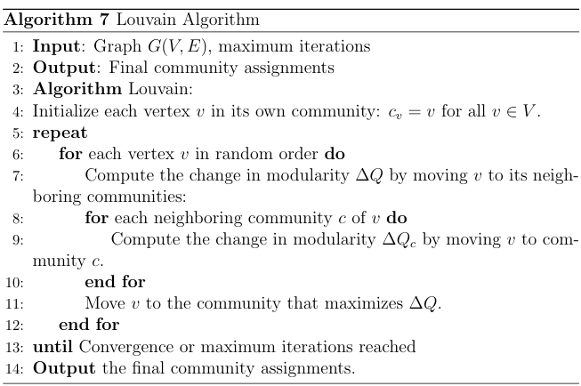
Algorithms/Methodology
7. Louvain Algorithm:
The Louvain algorithm is a popular community detection algorithm used to uncover modular structures in networks.
It aims to maximize the modularity of the network, which measures the quality of the division of nodes into communities.

Slide 24
Progress After First Review:
Earlier we had only implemented GCN.
Now we have implemented three more models- GAT, GraphSage, and Deep Graph Infomax.
We did this on the 3 datasets and later implemented clustering algorithms like K-means, Spectral and Louvain on each of them and compared the different methods.

Slide 25
Experimental Setup
Here we have experimented on three different datasets:
CORA DATASET
CITESEER DATASET
PUBMED DATASET

Slide 26
DATASET-1(CORA DATASET)
2,708 publications, each a node, with 5,429 edges representing citation relationships.
Attributes: Title, authors, abstract, venue available, suitable for graph tasks.
Commonly used to evaluate GNN performance for node classification, link prediction.
Valuable for testing algorithms in computer science due to diversity and relevance.
DATASET-2(CITESEER DATASET)
3,312 papers, each a node, with 4,732 citation relationships, reflecting complex scholarly connections.
Attributes: Includes title, authors, abstract, venue, aiding comprehensive analysis and exploration.
Unlike Cora, spans broader topics, resulting in a more challenging graph structure.

Slide 27
DATASET-3(PUBMED DATASET)
19,717 papers, 44,338 citation relationships, capturing breadth of biomedical knowledge.
Attributes: Includes title, authors, abstract, offering valuable contextual information.
Each paper represents a node, citation links depict research evolution.
Topics span genetics to clinical medicine, providing nuanced understanding of scientific literature.

Slide 28
Findings

Slide 29
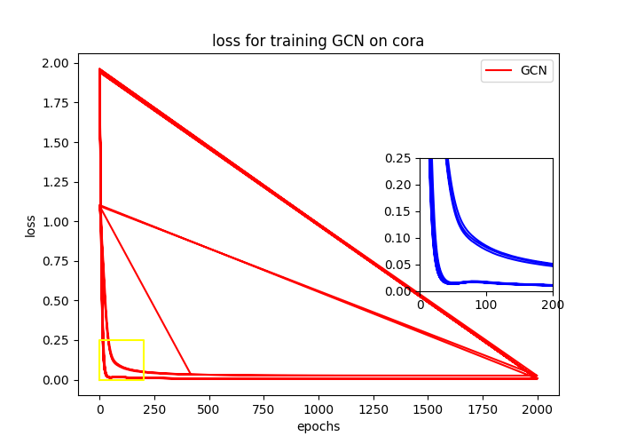
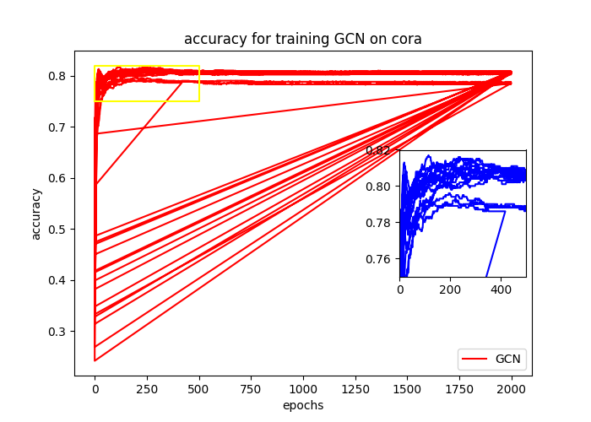
GCN on Cora Dataset

Slide 30
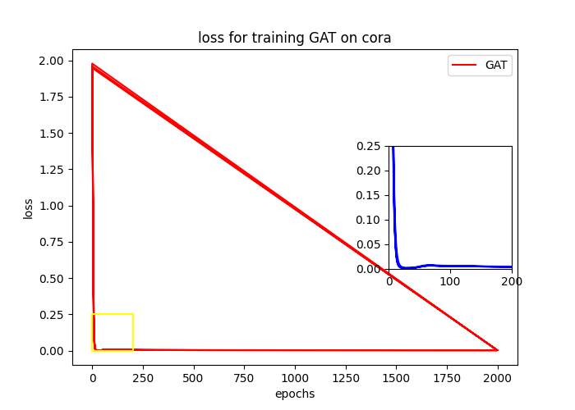
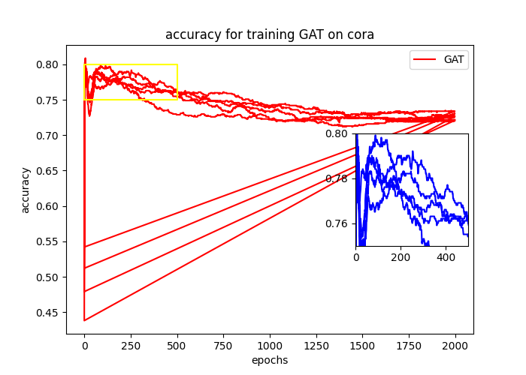
GAT on Cora Dataset

Slide 31
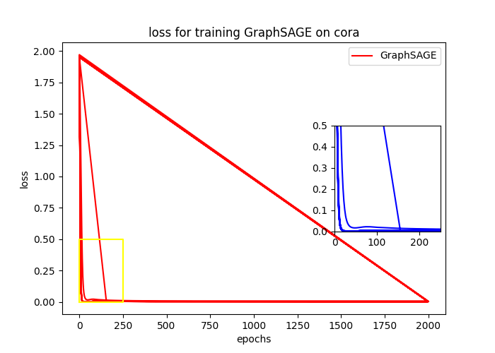
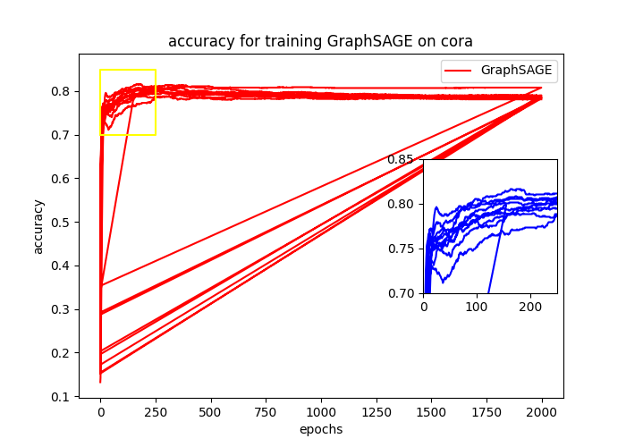
GraphSAGE on Cora Dataset

Slide 32
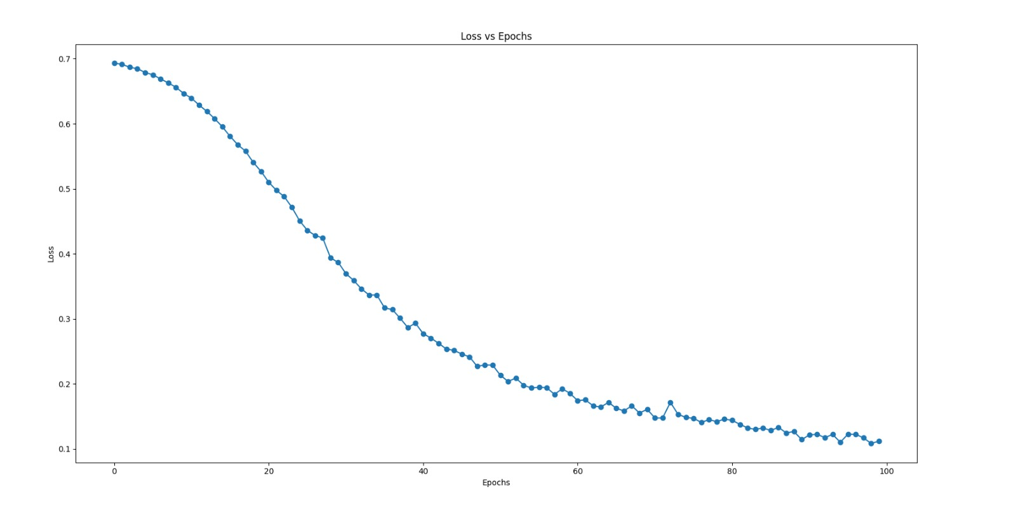
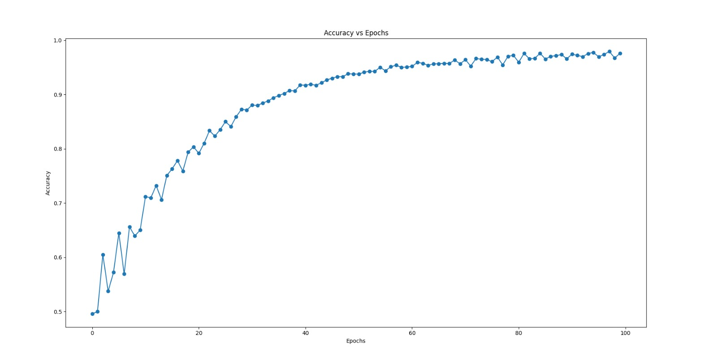
Deep Graph Infomax on Cora Dataset

Slide 33
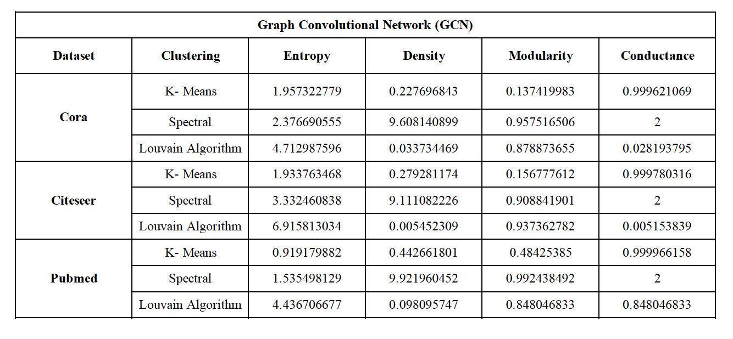
Clustering Result on GCN

Slide 34
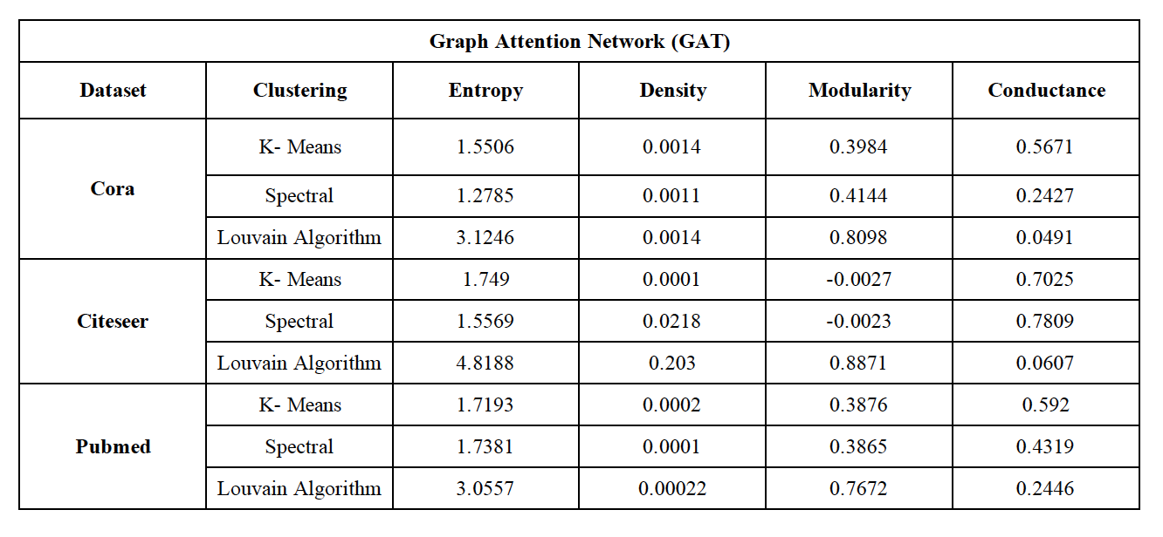
Clustering Result on GAT

Slide 35
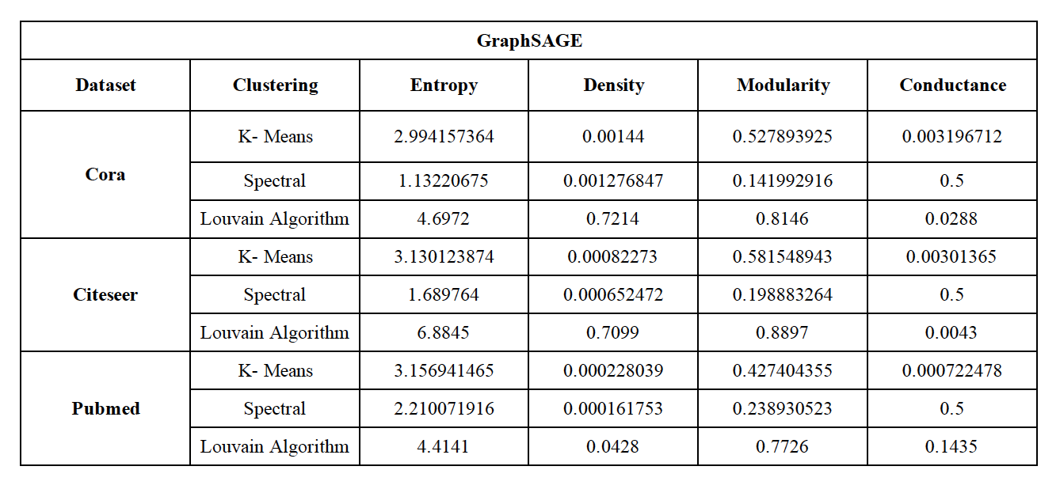
Clustering Result on GraphSAGE

Slide 36
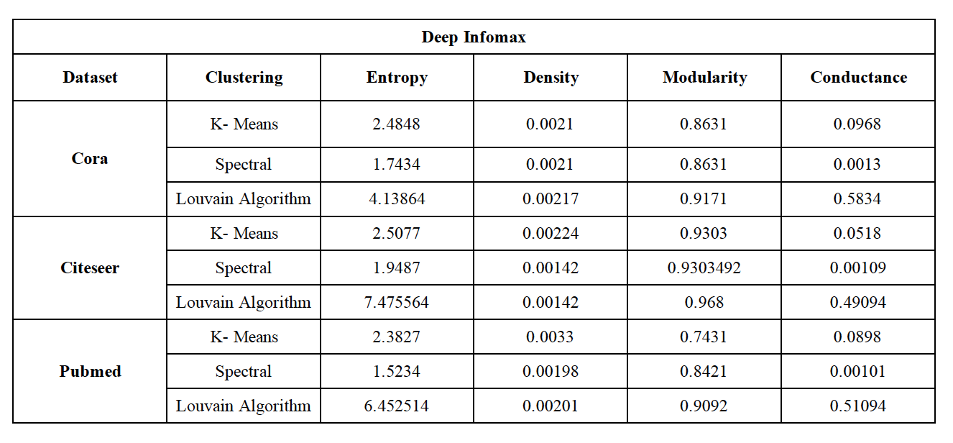
Clustering Result on Deep Graph Infomax

Slide 37
Results
Performance of GNN Models:
We evaluated four Graph Neural Network (GNN) models: Graph Convolutional Networks (GCN), Graph Attention Networks (GAT), Deep Graph Infomax, and GraphSAGE.
Across all three benchmark datasets (Cora, Citeseer, and Pubmed), GCN consistently achieved the highest accuracy, with accuracies ranging from 78.80% to 80.40%.
GAT and GraphSAGE also demonstrated competitive performance, achieving accuracies ranging from 60.40% to 70.70% and 76.50% to 78.10%, respectively.
Deep Graph Infomax exhibited varying performance across datasets, with ac curacies ranging from 72.92% to 81.01% .
Notes:
GCN : Cora 80.40
Citeseer : 68.90
Pubmed : 78.80
GAT:Cora 70.70
Citeseer : 68
Pubmed : 60.40
GraphSAGE : Cora 78.10.
Citeseer : 70.60
Pubmed : 76.50
Deep Infomax :Cora 81.01
Citeseer :72.92
Pubmed : 78

Slide 38
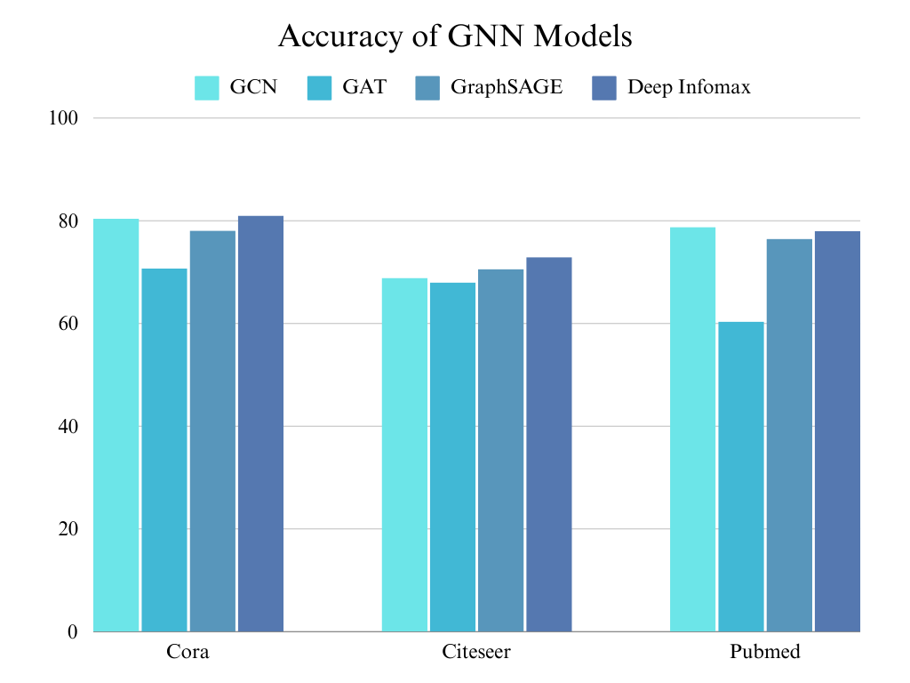

Slide 39
Clustering Analysis:
We applied traditional clustering algorithms, including K-means clustering (with the optimal value of K determined using the elbow method), Spectral clustering, and the Louvain Method.
The Louvain Method outperformed the other clustering algorithms, consistently yielding high-quality partitions with well-defined community structures.
Spectral clustering also demonstrated robust performance, particularly on datasets with clear spectral properties.
K-means clustering performed adequately, although its performance varied depending on the dataset and the chosen value of K.

Slide 40
Conclusion
Overall, our project conducted a thorough comparative analysis of graph neural network (GNN) methods and traditional clustering algorithms on benchmark datasets. We found that GNN methods, particularly Graph Convolutional Networks (GCN), demonstrated robust performance in capturing structural properties and learning representations of graph-structured data. The insights gained from our evaluation provide valuable guidance for selecting appropriate techniques in graph analysis tasks, laying the foundation for future research in the field of graph analytics and machine learning.

Slide 41
References
[1] A. Kesarwani, A. Singh, K. Gaurav and A. K. Shankhwar, "Leader Similarity Based Community Detection Approach for Social Networks," 2020 IEEE International Conference for Innovation in Technology (INOCON), Bangluru, India, 2020, pp. 1-6, doi: 10.1109/INOCO
[2] D. -D. Lu, "Leader-Based Community Detection Algorithm in Attributed Networks," in IEEE Access, vol. 9, pp. 119666-119674, 2021, doi: 10.1109/ACCESS.2021.3109124.
[3] Sun, Heli & Du, Hongxia & Huang, Jianbin & Li, Yang & Sun, Zhongbin & He, Liang & Jia, Xiaolin & Zhao, Zhongmeng. (2020). Leader-aware community detection in complex networks. Knowledge and Information Systems. 62. 10.1007/s10115-019-01362-1.
[4] Ahajjam, Sara & Mohamed, El Haddad & Hassan, Badir. (2018). A new scalable leader-community detection approach for community detection in social networks. Social Networks. 54. 41-49. 10.1016/j.socnet.2017.11.004.
[5] Yakoubi, Zied & Kanawati, Rushed. (2014). LICOD: A Leader-driven algorithm for community detection in complex networks. Vietnam Journal of Computer Science. 1. 241-256. 10.1007/s40595-014-0025-6.
[6] Shah, Devavrat & Zaman, Tauhid. (2010). Community Detection in Networks: The Leader-Follower Algorithm.

Slide 42
Thank You!

